Slide 1
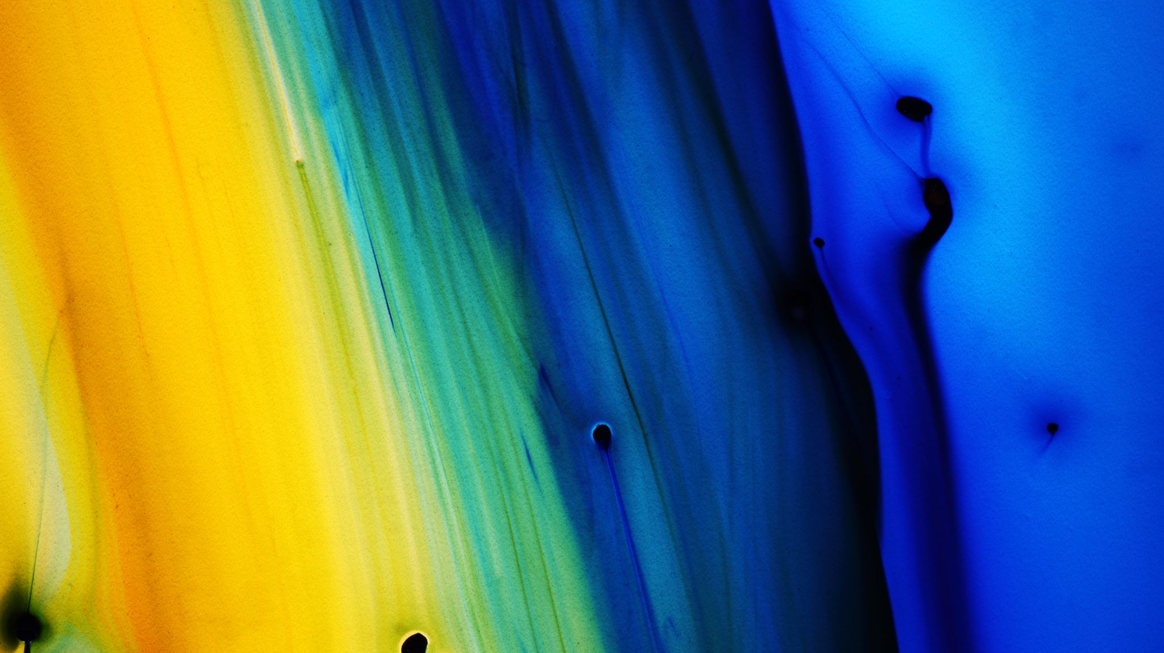
Playful Revision
By Kefalidis Vasilis ,Nikolaou Despina, Pallada Evagelia

Slide 2
Facts
Subjects involved: Science, Math, English, Computers, History, etc
Grade Level: A class of senior high school
Age: 15-16 years old
Number of Students:110
Duration: 3-4 hours
Previous knowledge: curriculum material of 2 terms

Slide 3
Standards & Alignment
Assessed Art Standards: Students can recognize the different Art technics and be able to apply them. (Pointilism, Collage, Mosaic, etc)
Assessed Content Standards: Students retrieve previous knowledge and apply learn skills.

Slide 4
Big idea – Essential question
Embrace different learning styles and motivate more students to revise through a more student friendly approach for the final exams.
Essential question: How can we make students feel less stressed while revising for the exams.

Slide 5
21st Century Skills
4 Cs (Critical thinking, Collaboration, Communication, Creativity)
Literacy Skills (information , Media, Technology)
Life Skills (Flexibility, Leadership, Initiative, Productivity, Social Skills)

Slide 6
Materials List
Coursebooks
Computer Lab
School Library
Maker Space
School Premises

Slide 7
Instructional Delivery (Collaborative, self-directed)
Student learning outcome: After revising the material taught students provide the correct solution/answer and create an artistic product.
Pre-engagement: Older students create an app which includes different sections for each subject with revision questions/problems. Also they create the QR codes that students use to enter the game. Teachers contribute by giving the questions/problems of their subjects.

Slide 8
Focal Lesson
Students form groups of 5 and each one scans the QR code of the game/app.
There are different sections with 5 questions for the different subjects.
They try to provide answers/solutions using skills, knowledge or research for each subject section (science, maths, computers etc ).
Only when they provide the correct answer do they move to the next level.

Slide 9
Focal Lesson
After completing each section successfully, they get an alphabet letter so they can form the name of a painter, scientist or a famous person. Based on that they create a piece of art (group decision) using artistic techniques that they have learned throughout the year. They give their final product to the teacher and then present it to the assembly and vote for the most creative and artistic one.

Slide 10
Feedback
The students feel in a questionnaire about the activity and how helpful they found it.
Things that they would like to be different or change.

Slide 11
Thank you

